Slide 1
Possible implications of a V/P shunt surgery on a congenitally-blind child’s academic and spatial-perceptual skills
A case-report
Waleed Jarjoura, Ph.D., Occupational Therapist
Head, OT Department, The Arab-American University, Palestine

Slide 2
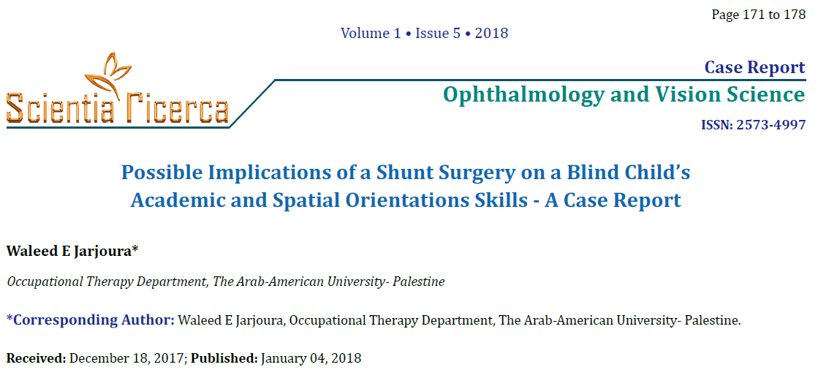
Scientific background

Slide 3
Prematurity, blindness and surgeries
Children with Visual-impairments, or Congenital blindness, confront various challenging experiences in life from early childhood and throughout their lifespan.
In some cases, infants with congenital blindness, especially due to prematurity, may suffer from intra-cranial pressure and, consequently, undergo V/P shunt surgery in order to prevent, or decrease, the risks for neurological symptoms and functional impairments .

Slide 4
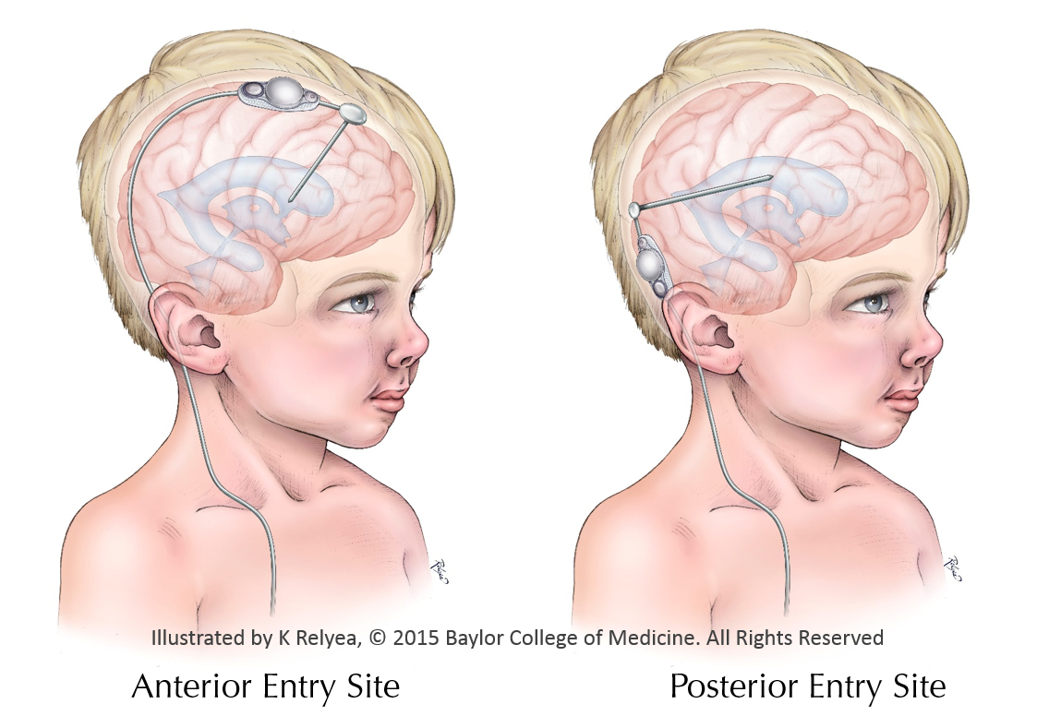
V/P shunt surgery procedure:
4. There are two options for the Catheter
insertion sites:
a- posterior site or b- anterior site

Slide 5
Prevalence of babies that may need Ventriculo-Peritoneal Shunt Surgery
The US National Institute for Neurological Disorders and Stroke (NINDS) estimates that 1 to 2 of every 1,000 babies are born with hydrocephalus.
Significant percentage of these children are also visually-impaired or totally-blind. These children are expected to acquire Braille reading, literacy skills, arithmetic, mobility and independence in basic daily activities in specialized schools.

Slide 6
BRAILLE-CODE LEARNING
Braille code learning requires spatial-perceptual skills and cognitive strategies related to the various components of Braille stimuli. As academic tasks become more complex and abstract, the visually-impaired children confront new challenges and cope with novel skills that require motivation, attention and concentration, visual-imagery, proficient consolidation of auditory memory and a rich lexicon (Jarjoura, 2012).

Slide 7
Implications of V/P Shunt malfunctions on the child’s vision and visual functions
V/P shunt surgeries aim to prevent the development of Hydrocephalus and its neurological signs and symptoms (Sherman & Wensheng, 2008), but in some cases, Ventriculo-Peritoneal Shunt Malfunction (VPSM) is quite common and may occur in up to 50% of operated pediatric patients (Dadlani, Dadlani, Ghosal & Hegde, 2015).
Visual loss associated with shunt failure remains a major morbidity in shunted congenital hydrocephalus.
(Oyama, Hattori, Kito, Maki, Noda, Wada, 2012).
Visual defects, including blindness, has been occasionally reported due to shunt malfunctions (Sunil, Payne, & Panda, 2011).

Slide 8
Shunt malfunctions…..continue…
An increased Intra-cranial pressure following the initial VP shunt malfunction may cause a deterioration in the visual acuity and bilateral optic discs atrophy in sighted children.
(Oyama, Hattori, Kito, Maki, Noda, Wada, 2012).
Shunt malfunction in children having Spina Bifida with spinal dysraphism, can lead to visual loss but the features may mimic those of Meningitis, and lead to a delayed referral and treatment. Thus, early shunt revision should prevent this complication (Shehu & Tunau, 2005).

Slide 9
VP shunt surgery in congenitally-blind children
In congenitally blind children, V/P surgery may pose specific additional challenges in the shape of dysfunctions in spatial orientation, spatial perception and tactile-reading of braille code: the most vital skills for blind individuals’ functions !
This is a rare complication of a second shunt surgery revision through the Posterior insertion site through the Parieto-Temporal cortex and the Intra-Parietal sulcus or the Lateral Occipital area of the Right Hemisphere.

Slide 10
A case-report
Jarjoura, W. (2018). Possible implications of a shunt surgery on a blind child’s academic and spatial orientation skills- A case report.
Ophthalmology and Vision Science, 1(5), 171-178.

Slide 11
A case-report
AR was born on 2-1-2004 as a premature infant (27 Weeks, 941 Grams)
APGAR score 1/4.
Placental Hemorrhage and Respiratory Distress Syndrome of the Newborn affected AR’s health condition.
He had convulsions and was immediately diagnosed with Optic nerve atrophy, Glaucoma and increased intra-cranial pressure, due to:
1. Intraventricular Hemorrhage of the Newborn- Grade III Rt.
2. Intraventricular Hemorrhage of the Newborn- Grade IV Lt.
………. which required a surgical intervention - V/P shunt implantation through the Right posterior-inferior parieto-temporal cortices into the right lateral ventricle.

Slide 13
A revision of the V-P shunt surgery
At age 6 years-old (birth date: 20-6-2010) AR underwent another V-P shunt surgery; a revision of the previous shunt that has been infected (by Entero-Bacteria) and blocked (obstructive Hydrocephalus).
The first V/P shunt was not removed due to the adherence of the catheter in the brain tissue. Thus, the second V-P shunt was inserted in an adjacent cortical area.

Slide 14
Enrollment in special education school for the blind/visually-impaired in Nazareth
2.5 months post surgery, AR entered 1st grade on (1-September-2010) at a special education school and was taught basic literacy skills in tactile Braille (in his mother-tongue Arabic), basic Math skills and the adapted school curriculum.
In addition, he was enrolled in therapeutic programs: PT, OT, Speech Therapy and Music therapy. AR had O&M training every week.

Slide 15
Braille Learning/Reading problems
Although standardized, well-established methods of Braille teaching were applied for three years, AR didn’t succeed to tactually discriminate any of the embossed Braille cells as compared to the basic 6-dot Braille cell, and He could not discriminate between the single dots that constitute each template!
As a results, AR could not establish the initial association between each tactual Braille template and its congruent phonological representation in Arabic Alphabet in order to develop phonetic spelling and basic reading skills (not due to auditory-memory difficulties!)

Slide 16
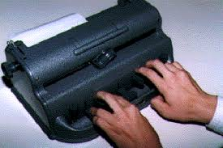
Other difficulties in Literacy skills
Braille printing skills (parallel to writing…)
Braille printing tasks were initiated in order to facilitate copying and printing skills but intensive repetitions of bilateral manual usage of the Perkins-Brailler did not result in efficient and purposeful outcomes, due to the lack of a precise timing of bilateral performance and the lack of precise
and sufficient motor sequencing.

Slide 17
Acquired, pure Acalculia?!
Finger counting was intensively exercised and repeated through the first years at school by different educators, through various teaching strategies focusing on fingers' naming, sequence and counting in one hand and in both hands.
Currently, at the age of 14, AR still does not succeed to count his fingers in the accurate sequence nor in showing the number of fingers equivalent to a number previously mentioned verbally or to the number of familiar items and objects.

Slide 18
Acquired, pure Acalculia?!
AR also has an incapability to compare amounts, measures and numbers nor to calculate simple additions, subtractions and multiplications
It seems that AR has the characteristics and signs of Acalculia of the spatial type.
The Right posterior-parietal cortical areas and the sub-cortical regions are associative areas that serve the spatial functions and the spatially-based procedural knowledge but also arithmetical procedures and numerical abilities (Nieder & Dehaene, 2009; Denburg & Tranel, 2012).

Slide 19
Orientation and Mobility training
AR was trained for three years by a qualified Orientation and Mobility (O&M) trainer both at the school and in AR's local, familiar environment.
Although training and repetitions (to generate procedural knowledge) and instructions, guidance and directions (to generate declarative knowledge) were applied repeatedly and intensively, AR still need individual accompanying even inside the “familiar” school and at home.

Slide 20
Basic Activities of Daily-Living (BADL)
AR is still fully-dependent in the various basic ADL activities, especially these demanding spatial perception, spatial orientation and sequencing regarding basic own-body’s schema, Left-Right discrimination… (e.g., Buttoning, Shoe-lace tying… )

Slide 21
“Gerstmann syndrome” in the blind!
The previously described symptoms, together with the dyscalculia and the profound typing/writing disability suggest a Gerstmann syndrome in a blind individual – usually, due to a lesion of the Left parietal cortex - in line with the perinatal intraventricular bleeding pattern - Thus a bilateral parietal cortex injury is indicated in AR based on the complications of the second V/P shunt revision surgery.

Slide 22
A third V-P shunt surgery in the near future !
AR is currently being evaluated prior to a planned third V-P shunt surgery due to a significant increase in the adolescent AR’s height that requires a replacement of the catheter.
A dilemma in decision-making, medical risks, and functional challenges will be expected “just around the corner”.

Slide 23
Comparable case-report at the same school
R.B., 16-years-old sighted female, with Spina Bifida, Hydrocephalus, Her 1st shunt surgery was at age 2-Months in the left, posterior entry site.
Intracranial pressure ate age 8 years-old (second grade, regular school), caused significant bilateral deterioration in vision, thus leading to a second revision shunt surgery in the left, posterior entry-site, adjacent to the first one.
No cognitive nor perceptual dysfunctions were diagnosed so far, Learning in tactile braille, age-equivalent intellectual level, Typical literacy skills in all domains of education, intact communication and social competencies.
Even when both shunt entry-sites penetrate through the VWFA in the left hemisphere, it seems that there are no impacts on tactile braille reading that is dependent on the spatial-perceptual processing in the Parieto-Temporal Cortex in the posterior-inferior area in the right hemisphere!

Slide 24
Discussion
Although surgeries, such as V/P shunt are crucial and necessary, they may have comprehensive implications on the blind child’s acquired skills and competencies in early childhood or, and on the acquisition of formal Literacy later-in-life.
Prenatal complications (e.g., Hemorrhage) may lead to comprehensive dysfunctions, but correctional VP-shunt surgeries in the posterior entry-site in the right cortex may be the cause for specific spatial-related dysfunctions in blind children tat can not compensate for it by sight and visual perceptual skills.
Special education teachers and therapists help the child to regain/restore some skills or to compensate for the lost ones. But in the case of AR, the lost skills and profoundly impaired competencies were not restorable and could not be significantly compensated for, leading to devastating dysfunctions.
The various difficulties of AR will prevent his enrollment in an inclusion mainstream school.
Moreover, AR will not proceed to a regular high-school nor to a college in contrary to other blind individuals who gained Literacy, meaningful occupations and Academic professions in order to become qualified professionals in education for the new generation of the blind children as an optional, adaptive life-role.

Slide 25
Conclusions
The question of Life-Saving procedures vs. Quality-of-life and self-esteem, constitutes the heart of the Dilemma in the case of AR, and other similar cases.
V/P shunt surgeries are inevitable, but I believe that the scientific, medical and technological advancements will find new protocols for such surgeries, and other surgical procedures, that decrease the risks for functional disabilities and neurological lesions which cause Alexia/Acalculia/Agraphia and other spatial-related perceptual disorders in infants and very young individuals with blindness.
When dealing with blind infants and children, neurosurgeon should reconsider cortical areas that are critical for spatial perception and spatial-cognition in the Right, Ventral Visual Area and Parietal Cortex and, therefore, try to avoid it and consider other neural pathways for V/P shunt with lesser functional implications (e.g., The Left Ventral-Visual Area and VWFA in the blind infants/children).

Slide 26
Although the case of AR is relatively rare and seems to be an individual case and does not represent the majority of children with prematurity, but…
I believe that each child is a unique person who has The right to gain literacy, reading and writing, independence, orientation and mobility, social participation, an adapted profession, meaningful life and influential life-roles.

