Slide 1
Unleashing the Potential of AI in the Digital Transformation of the financial services
Mohammed Kateeb

Slide 2
The Storm
The Fourth Industrial Revolution
Sparked a profound shift in our lives, work, and interactions, driven by a set of transformative technologies including AI.
Changed all aspects of our lives. It triggered a complete social revolution that not only has an economic impact, but also political, social and others.

Slide 3
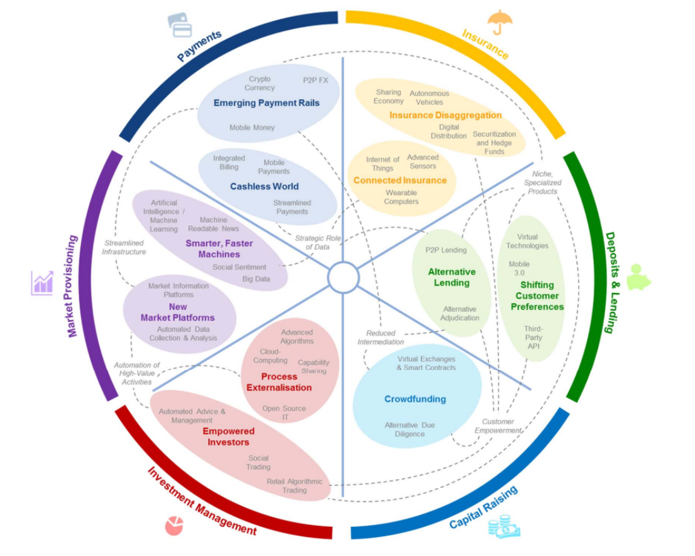
Industry 4.0 – The FinTech Disruption
Ignited a wave of digital transformation across the Financial Sector.
Fintechs are created from the womb of this revolution. Startups around the world realized that they could democratize financial services and provide great customer experience.
New era where a new global, regional, and local ecosystems were created. These ecosystems relied on vertical and horizontal partnerships forged between incumbents, with fintechs, neobanks and other disruptors, and ultimately with third parties to create entirely new classes of financial services and fresh revenue streams.
Fintech allowed access to new markets, innovative, low-cost personalized products, and greater efficiencies.

Slide 4
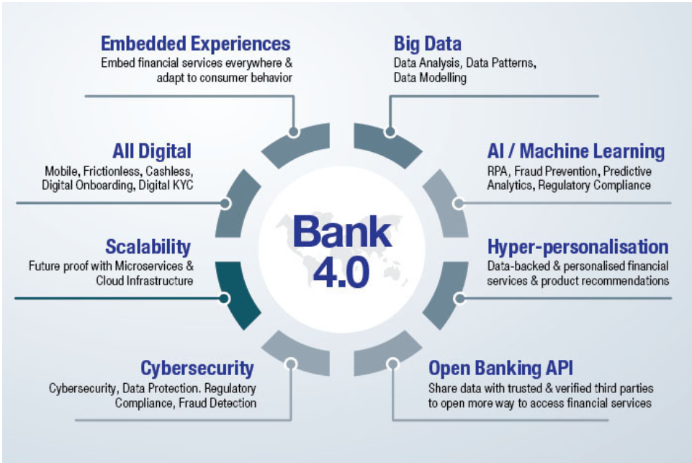
The incumbent's response
Enhance digital banking
Partner with fintechs
Acquire fintechs
Launch digital attackers
Invest in innovation
The regulators’ response
OPEN banking API
Sandboxes, innovation hubs, and accelerators
Aggressive regulations (EU PSD2, UK Open Banking)
Promoting financial inclusion and innovation

Slide 5
NEO Banks update
Neo banks are facing some challenges in the current market:
Competition from traditional banks:
Regulatory hurdles: Some neo banks have faced regulatory scrutiny and challenges in obtaining banking licenses and complying with various rules and standards. For example, Digit was fined by the Consumer Financial Protection Bureau for falsely advertising a no-overdraft guarantee.
Low profitability: Some neo banks have struggled to generate revenues and profits from their low-fee or no-fee business models. For example, Monzo reported a loss of £113.8 million ($156.4 million) for the fiscal year ending February 2022.
Customer retention: Some neo banks have faced difficulties in retaining customers and increasing their engagement and loyalty. For example, a survey by Momentive found that only 29% of US digital banking customers use their neo bank as their primary account .
Banking Crisis caused major trust issue. Silicon Valley Bank (SVB), First Republic Bank (FRB) and Signature Bank — accounted for 2.4% of all assets in the US banking sector. The failure of Credit Swiss in Europe.

Slide 6
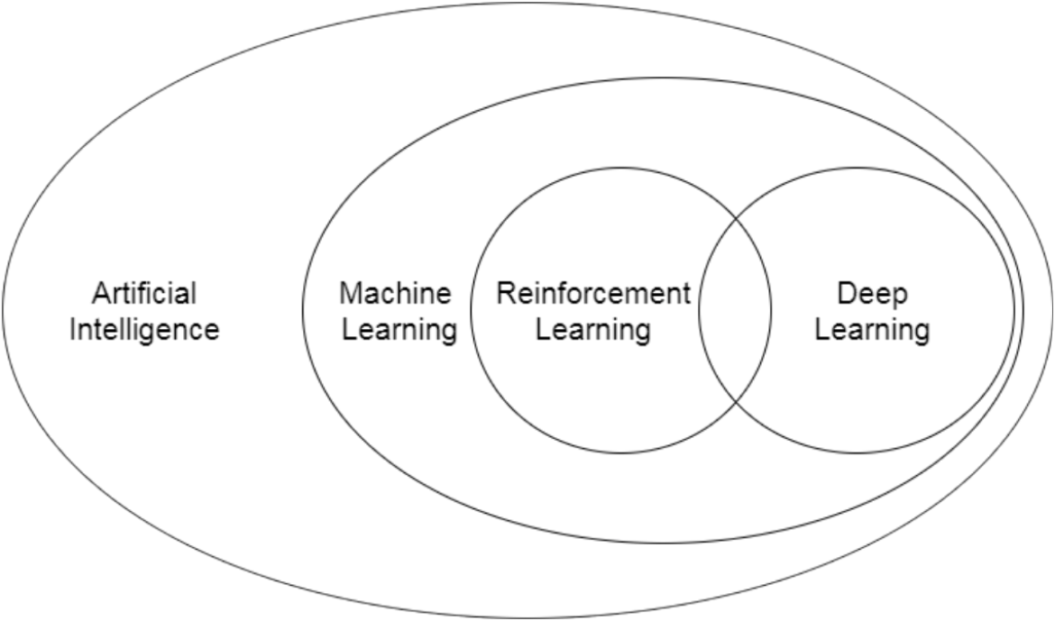
The real Storm THE AI REVELOUTION
“AI is one of the most important things humanity is working on. It is more profound than, I dunno, electricity or fire,” says Pichai, GOOGLE
OpenAI’s ChatGPT: Most significant tech launches since the original Apple iPhone in 2007. The fastest-growing consumer app in history, hitting 100 million users in the first two months after its release.
Google’s Bard
TII’s Falcon – Open Source LLM
The Year of Large Language Models (LLMs), how does it work?
Opportunity: Train LLM on private data of any organization.

Slide 7
The Impact of AI on the financial services industry has been transformative

Slide 8
Data-driven Decision-making
AI is the bridge between data and insights, transforming information overload into actionable knowledge.
AI leverages data analytics to provide actionable insights for financial institutions. It can analyze historical and real-time data, identify trends, and generate accurate forecasts.
Investment Decisions
Customer Segmentation
Pricing and Profitability Analysis
Regulatory Compliance
Customer Lifetime Value (CLV) Analysis
Risk Management

Slide 9
Data collection and analysis
Some banks use AI to collect and analyze large volumes of data from internal and external sources to enhance their operations and performance.
HSBC uses AI to automate data extraction from documents such as contracts, invoices, and receipts to reduce manual errors and save time.
Predictive analytics
Some banks use AI to generate predictions and forecasts based on historical data and current trends.
Bank of Montreal uses AI to predict customer churn and retention rates by analyzing customer feedback and behavior.

Slide 10
Improved Customer Experience
By leveraging AI technologies, financial institutions can deliver tailored, convenient, and user-friendly experiences that meet the evolving expectations of their customers.
Personalized Recommendations
Intelligent Customer Service
Virtual Financial Advisors
Chatbots and Virtual Assistants
Seamless Digital Onboarding
AI-powered virtual assistants
Cleo offer personalized budgeting, saving, and spending tips based on individual financial goals and habits
Kensho Technologies uses AI to analyze data from various sources such as news articles, social media, and market conditions to generate insights and recommendations for its clients.
Wells Fargo uses AI to send personalized alerts and guidance to its customers based on their spending patterns, financial goals, and life events23.
Bank of America uses AI to analyze customer spending patterns in order to provide personalized financial advice.

Slide 11
Conversational banking
Many banks use chatbots to provide conversational banking to their customers, such as answering queries, providing account information, and offering financial advice. Many banks use chatbots to provide conversational banking to their customers, such as answering queries, providing account information, and offering financial advice.
Bank of America’s Erica chatbot has more than 10 million users and can handle a variety of tasks such as bill payments, credit score updates, and budgeting tips.
Ally Financial’s chatbot can handle a variety of tasks such as bill payments, credit score updates, and budgeting tips12.

Slide 12
Advanced Risk Management
AI algorithms can analyze massive datasets, identify patterns, detect anomalies, and predict potential risks. This helps in mitigating risks, preventing fraud, and making informed decisions.
Fraud Detection and Prevention
Anti-Money Laundering (AML) Compliance
Market Risk Analysis
Credit Risk Assessment
Cybersecurity Threat Detection
Compliance Monitoring
AI is being used to assess risk in a variety of financial applications, such as credit scoring, portfolio management, and insurance underwriting. This can help financial institutions to make more informed decisions about lending, investing, and pricing insurance.
BlackRock uses AI to assess the risk of thousands of different assets in order to manage its investment portfolios.

Slide 13
Fraud detection
AI is being used to detect fraudulent transactions in real time. This can help financial institutions to protect their customers from fraud and to reduce their own losses
Mastercard uses AI to analyze billions of transactions every day to identify patterns that could indicate fraud.
Cybersecurity
Some banks use AI to detect and prevent cyber threats and attacks by using anomaly detection, biometric authentication, and behavioral analysis
Citibank uses AI to detect anomalies and suspicious activities in its transactions and networks to prevent fraud and cyberattacks.
Vectra AI uses AI to monitor network traffic and identify suspicious activities and patterns

Slide 14
Compliance and Regulatory Support
Used to comply with complex regulatory frameworks and various standards such as AML, KYC, Basel III, and General Data Protection Regulation (GDPR). Reducing compliance costs and enhancing the overall regulatory posture of financial institutions.
Automated Regulatory Reporting
KYC and Customer Due Diligence
Privacy and Data Protection
Transaction Monitoring
Regulatory Change Monitoring
Audit and Monitoring
Deutsche Bank uses AI to automate its AML processes by screening customers and transactions against watchlists and databases.

Slide 15
Loan and credit decisions
Some banks use AI to improve their loan and credit decision processes by using alternative data sources and advanced analytics to assess the creditworthiness and risk profile of borrowers.
JPMorgan Chase uses AI to analyze data from various sources such as tax returns, bank statements, and market conditions to provide faster and more accurate lending decisions.
Zest AI, for instance, employs machine learning models to analyze bank transactions, utility payments, and social media activity, resulting in more accurate and fair credit scores.

Slide 16
Algorithmic Trading
Algorithmic trading has revolutionized financial markets, contributing to increased liquidity, improved market efficiency, and reduced trading costs.
AI is being used to trade financial assets more quickly and accurately.
High-frequency traders use AI to analyze market data and to place trades in milliseconds.
Execution Speed and Efficiency
Sentiment Analysis
Quantitative Trading Strategies
Market Making
Trend Following
High-Frequency Trading (HFT)

Slide 17
Portfolio management
AI is being used to manage investment portfolios more efficiently and effectively
Robo-advisors use AI to create and manage investment portfolios for clients based on their individual goals and risk tolerance.
BlackRock leverage AI to provide investment signals and alerts to their clients.
JP Morgan trained ChatGPT like LLM on its private data (Ref. LinkedIn).
Investment research
AI is being used to research investments and to identify potential opportunities. This can help investors to make more informed decisions about where to allocate their money.
Goldman Sachs uses AI to analyze data from millions of different sources in order to identify investment opportunities.

Slide 18
Innovation and Competitive Edge
Looking at The future, things will get even more interesting..
AI-driven technologies,
Blockchain, digital currencies, decentralized finance (DeFi),
Robotics,
Metaverse and Augmented reality,
Quantum Computing – will change everything,
And much much more..
These technologies are reshaping the financial landscape. Embracing these technologies allows organizations to stay at the forefront of innovation, develop new business models, and remain competitive in an evolving market.

Slide 19
AI Challenges
ETHICAL CONSIDERATIONS
Human values, and ethical reasoning to ensure fairness and accountability becomes crucial.
Data PRIVACY
Protecting individuals' privacy becomes paramount. Robust data governance frameworks, stringent security measures, and transparent data practices are necessary to maintain trust and protect sensitive information.
TRANSPARENCY
Bias in AI algorithms can perpetuate existing inequalities and discrimination, making it imperative to address and mitigate bias in data and algorithmic models.
JOB DISPLACEMENT
Reskill and upskill the workforce to adapt to changing roles and ensure a smooth transition in the labor market
Notes:
However, while the potential of AI in digital transformation is vast and promising, embracing AI in digital transformation comes with challenges. As AI becomes more pervasive, concerns about ethical considerations, data privacy, transparency, bias, and job displacement are areas that need careful attention. It is crucial to acknowledge and address the challenges and potential negative impacts associated with its adoption.
Ethical considerations play a vital role in AI development and deployment. As AI systems make decisions that impact individuals and society, ensuring fairness, accountability, and transparency becomes crucial. Bias in AI algorithms can perpetuate existing inequalities and discrimination, making it imperative to address and mitigate bias in data and algorithmic models.
Data privacy is another critical concern in the age of AI. As organizations collect and analyze vast amounts of data, protecting individuals' privacy becomes paramount. Robust data governance frameworks, stringent security measures, and transparent data practices are necessary to maintain trust and protect sensitive information.
Furthermore, the potential impact of AI on jobs and employment must be carefully managed. While AI can automate routine and repetitive tasks, it can also create new opportunities and enhance human capabilities. It is essential to reskill and upskill the workforce to adapt to changing roles and ensure a smooth transition in the labor market.
Maintaining human oversight and control is crucial when deploying AI systems. While AI can make complex decisions, human judgment, values, and ethical reasoning are irreplaceable. Designing AI systems that augment human decision-making rather than replace it, is key to preserving our humanity.

Slide 20
Navigating AI Challenges
Establish robust governance frameworks for AI
Ethical guidelines, regulatory oversight, and accountability mechanisms. Collaboration between industry, academia, and government is vital to develop standards, best practices, and policies that promote responsible AI development and deployment.
Adopt best practices
developing a clear AI strategy, investing in AI talent and infrastructure, fostering a culture of innovation, and ensuring transparency and accountability in AI-driven decision-making.
Prioritize our humanity and work
AI technologies align with our values, respect our privacy, and contribute to a sustainable and inclusive future.
Notes:
To navigate these challenges, organizations and policymakers must establish robust governance frameworks for AI. These frameworks should encompass ethical guidelines, regulatory oversight, and accountability mechanisms. Collaboration between industry, academia, and government is vital to develop standards, best practices, and policies that promote responsible AI development and deployment.
To harness the power of AI successfully, organizations must adopt best practices. This includes developing a clear AI strategy, investing in AI talent and infrastructure, fostering a culture of innovation, and ensuring transparency and accountability in AI-driven decision-making.
By addressing these challenges proactively and managing the potential negative impacts of AI, we can ensure that AI technologies align with our values, respect our privacy, and contribute to a sustainable and inclusive future. As we continue to embrace the potential of AI, let us prioritize our humanity and work towards harnessing the power of AI to enhance our lives, create opportunities, and solve some of our organizations’ and the world's most pressing challenges. It is essential to manage AI implementations carefully to ensure that our humanity continues to thrive.

Slide 21
SUMMARY
AI's potential in digital transformation is reshaping industries across the board.
By embracing AI and leveraging its capabilities, organizations can unlock new possibilities, stay ahead in the competitive landscape, and meet the evolving needs of customers.
As AI becomes more pervasive, concerns about ethical considerations, data privacy, transparency, bias, and job displacement are areas that need careful attention.
Actions Needed
I urge all of you to explore the potential of AI in your respective organizations and industries and analyze its impacts, potential, and challenges.
Embrace digital transformation, invest in AI talent and technology.
Envision a future where AI-powered innovation drives growth, efficiency, and customer-centricity. Doing that will unleash the potential of AI and shape a brighter future for all industries in our beloved Palestine.
Mohammed Kateeb, Strategic Advisor
linkedin.com/in/mohammedkateeb

