Slide 2
Microsoft Cybersecurity Insight in the Age of
Digital Transformation
Ayman Al-Takrori
Microsoft Arabia

Slide 3

What is Digital Transformation?

Slide 4





Digital Transformation
Pillars
Empower
Employees
Employees
Engage
Customers
Transform
Products
Customers
Products
Operations
Optimize
Operations

Slide 5
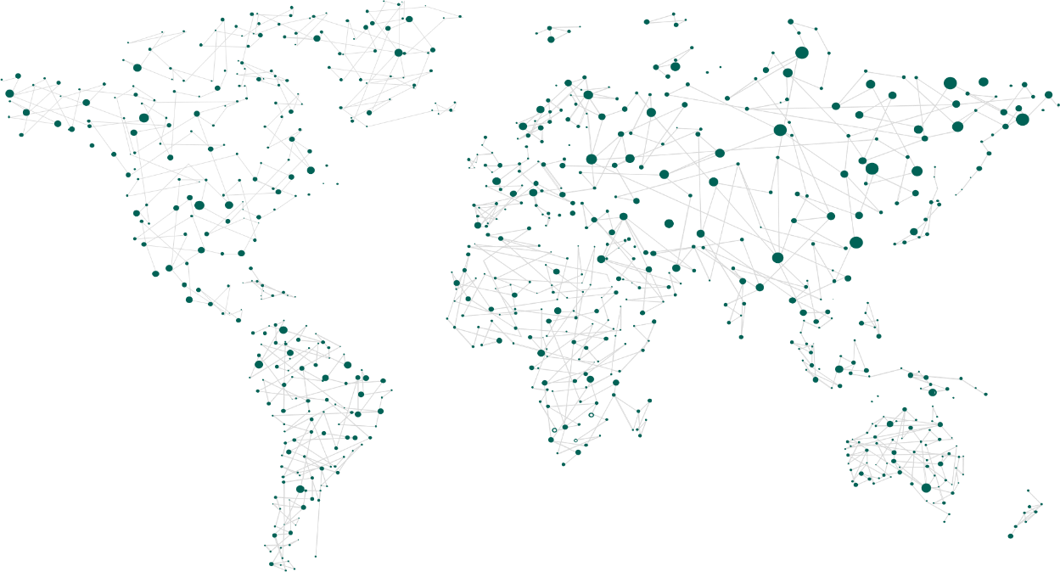







Digital Transformation
The Microsoft Platform
Applications
Microsoft 365
+ Dynamics 365
Power Platform
Azure
Data
Microsoft Graph

Slide 6
Digital Transformation
for Business Leaders
91%
See Digital Transformation as a way of
Finding Efficiencies
68%
say Digital Transformation is Increasing Profits
85%
say they must offer digital services or Become Irrelevant
64%
say they have less than 4 years to complete a Digital Transformation
or they may Go out of Business

Slide 7
The world is transforming rapidly
Market
Business
Attackers
Technology
Security

Slide 8
Working together
Business
Market
Attackers
Technology
Security

Slide 9
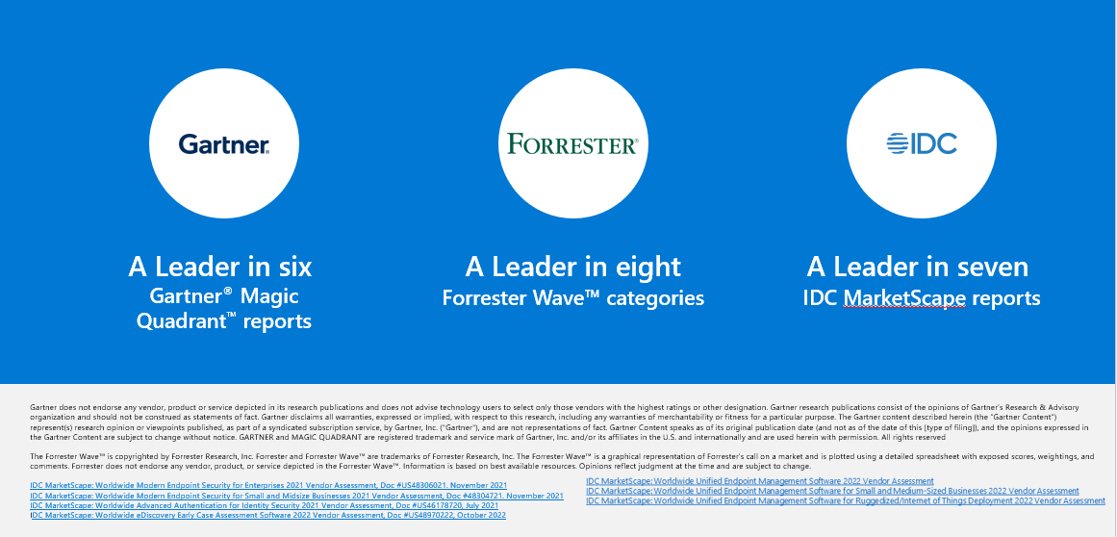
A leader in security, compliance, identity,
& management

Slide 10
Operation Scale
Meeting
minutes delivered
4.1B+
URLs scanned
18M+
1.8PBs
1.2B+
Other clouds
and network logs
PCs, servers,
and IoT
Trillions of signals
Emails
analyzed
470B+
Billions of predictions
Identities authenticated
630B+
Millions of actions
Microsoft Cloud
Machine learning and AI systems
Documents scanned
600B+
1B+
iOS, macOS, Android, Linux
and IoT devices
Apps and
service users
Threats blocked
5B+

Slide 11



Navigating a shifting world
Conventional security tools have not kept pace
Attacks growing
more sophisticated
Regulatory landscape
becoming more complex

Slide 12
Microsoft Security
Protect
Detect
Respond

Slide 13
Secure your organization with Zero Trust
Verify explicitly | Use least-privileged access | Assume breach
Data
Identities
Apps
Infrastructure
Devices
Security policy enforcement
Network

Slide 14
Final Word – Government/PS
Encourage Cybersecurity Investment – Rather Demand it
Support Cybersecurity Investment – Fund, Tax Reduction … etc
Support taking down the attackers – Make it easier – Cooperation Programs with Security Vendors/Private Sector – Be Proactive
Help enhance education outcome for IT/Security and support industry certification – there is a huge lack of resources

