Slide 2
The Role of Universities in the Future of Employment: Thoughts and Reflections
Dr. Adli Saleh
Advisor to the Board of Directors for Planning, Development, and Quality

Slide 3
Un-Employment rates in Palestine
Source: Palestinian Central Bureau of Statistics

Slide 4
4th SDG: Quality Education

Slide 5
What is Quality?
Meeting customers’ expectations
Conformance to requirements
Degree of Excellence

Slide 6
The AAUP’s Framework for Quality

Slide 8
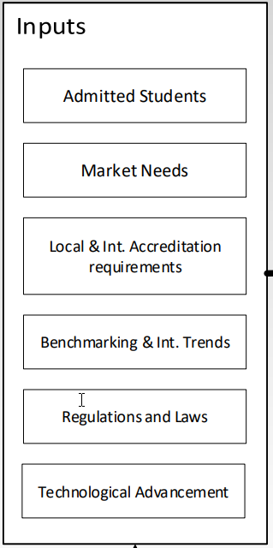
Inputs
Market Needs
Benchmarking & International Trends
Technological Advancement

Slide 9
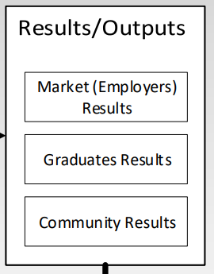
Outputs
Evaluating Employers’ and Graduates’ Results
Surveys
To assess the readiness of graduates to meet the market needs

Slide 10
AAUP’s Approach to Digital Transformation
Digitalizing The Educational Processes
Development of new academic programs
Integrating technology in teaching and learning

Slide 11
Digitalizing The Educational Processes

Slide 12
Development of new academic programs
Faculty of Data Science
Finance and Data Science
Financial Engineering
Statistics and Data Science
Virtual Reality Science
Faculty of Modern Sciences
Digital Economy
Digital Health
Digital Management of Business
Digital Marketing
Industrial Product Design
Interior Architecture
Optometry
Political Science and Digital Diplomacy
Sustainable Development and Technology
Technology Management and Pioneering
Technology, Culture and Society
Virtual Reality Arts
Faculty of Modern Media
Communication and Social Media
Digital Media
Public Relations

Slide 13
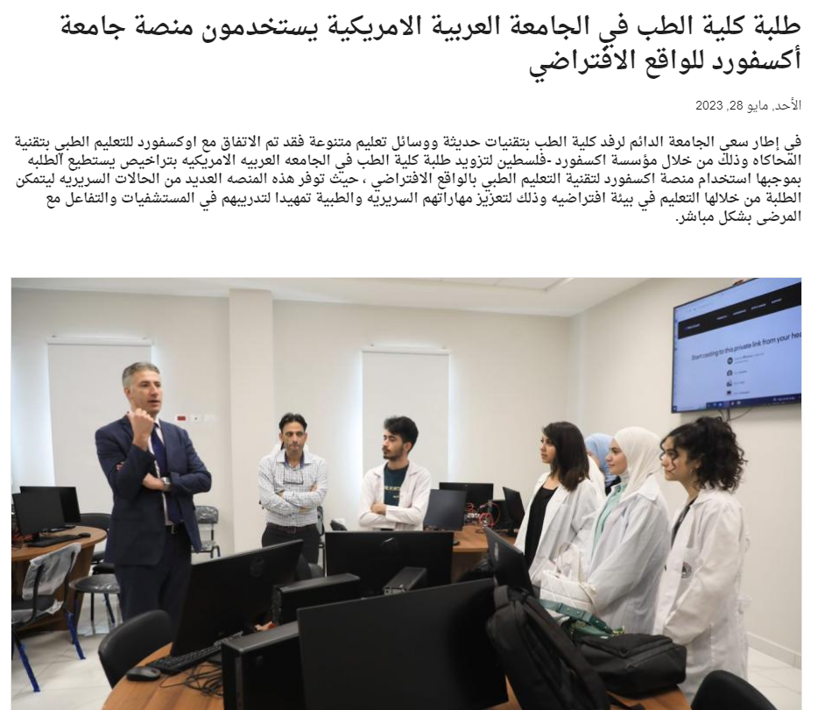
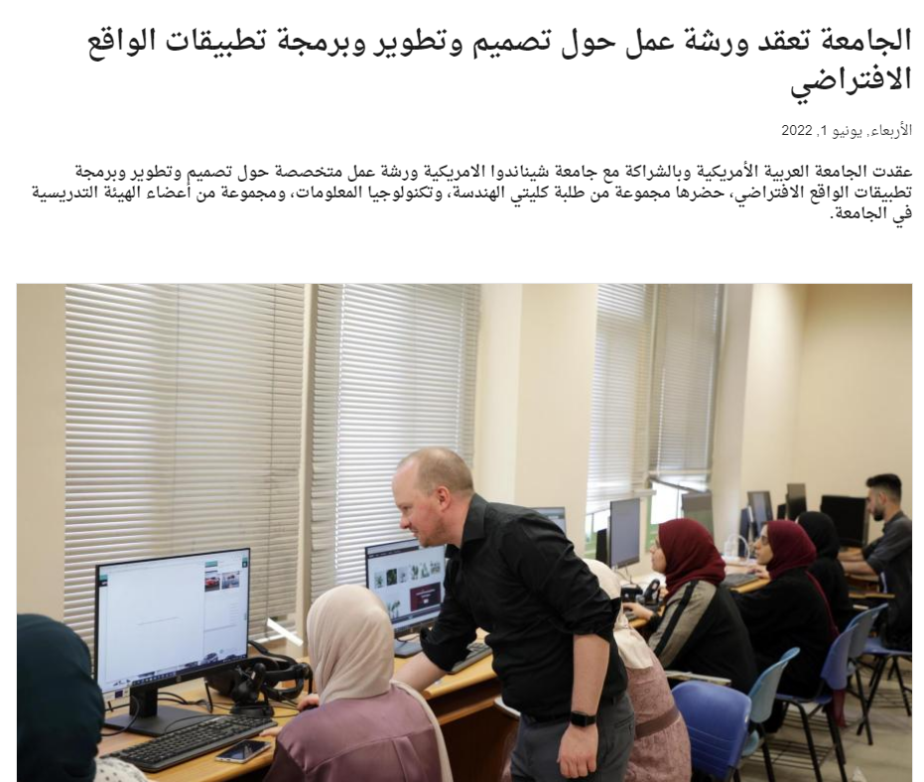
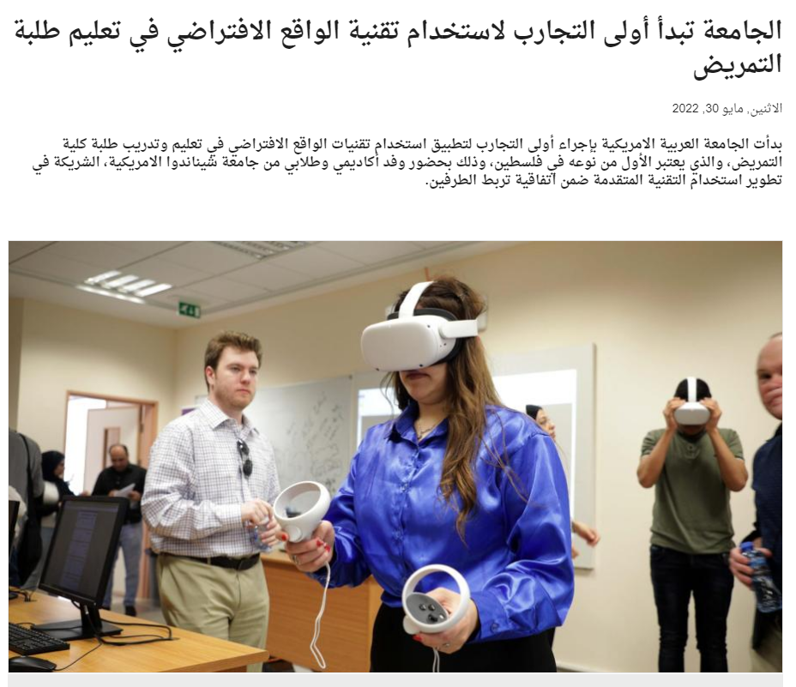
Integrating Technology in teaching and Learning

Slide 14
Upcoming Challenges
The gap in transition speed between education and digital transformation
Employers are seeking more technical experience than scientific knowledge
Lack of HEIs resources needed to cope with digital transformation requirements
The decline of certain academic disciplines and the emergence of new fields

Slide 15
Upcoming Challenges
The timid relationship between markets and higher education and the lack of support between them
Ethical challenges:
The need to close programs and establish others
ChatGPT
Data security and privacy

