Slide 1
The New
Microsoft
Ayman Al-Takrori
Microsoft Arabia

Slide 2
Our mission
Empower every person and every organization on the
planet to achieve more

Slide 3
Customer Feedback on their Need
Rightsized Subscriptions
Governance
Consumption Management
Cost Optimization
Data Driven Decisions
Optimized Configurations
Minimized Waste
Security
Digital Transformation

Slide 4
What is Digital Transformation?
Digital transformation:
* A business-wide initiative to integrate intelligent technology into all areas of the business to achieve better outcomes and optimized performance & business processes.
* The process of using digital technologies to create new - or modify existing - business processes, culture, and customer experiences to meet changing business and market requirements.

Slide 5
What is Digital Transformation?
Digital transformation: The evolving pursuit of innovative and agile business and operational models - fueled by evolving technologies, processes, analytics, and talent - to create new value and experiences for customers, employees, and stakeholders.

Slide 6


Digital Transformation
Pillars
Empower
Employees
Employees
Engage
Customers
Transform
Products
Customers
Products
Operations
Optimize
Operations

Slide 7

Digital Transformation
The Microsoft Platform
Applications
Dynamics 365
Microsoft 365
Azure
Data
Microsoft Graph

Slide 10
Summary of Microsoft 365
PRODUCTIVITY
COLLABORATION
SECURITY
E5 SECURITY
E5 COMPLIANCE
ANALYTICS
VOICE
Office Pro Plus
Office apps on up to 5 PCs & Macs
Mobile Office Apps
Office Apps for Tablet & Smartphones
Windows 10 Enterprise – per user
My Analytics:
Individual and team effectiveness
Exchange :
Business-class email & Calendar
OneDrive:
Cloud Storage and file sharing
SharePoint:
Team sites & internal portals
Skype for Business:
Online Meetings, IM, video chat
Yammer:
Private social networking
Teams
Persistent chat/video-based collaboration with reach communication platform
Planner
Forms
PowerApps
Anti Virus :
Signature based AV/AS
Data Loss Prevention
Prevent sensitive data leaks
Basic eDiscovery
Discovery content across email, docs, IM, social.
Azure AD Premium P1
SSO, MFA, Conditional Access, Reporting
Intune
MDM, SCCM, Endpoint Protection
Azure Info Protection Premium P1
Encrypt and track all files
Adv Threat Analytics
Protection from advanced targeted attacks by applying user and entity behavior analytics
Secure Score
Assesses your current O365 security health
Compliance Manager
Track compliance against regulatory requirements
Defender For O365:
Zero-day virus and malware protection with attack simulator
Adv Threat Intelligence
Global machine learning based threat detection and prevention; Enhanced data access controls (CLB)
Cloud App Security
Discover cloud-based apps, gain insight into shadow IT and assess risk.
Azure AD Premium P2
Risk based conditional access, privileged Identity Management, identity protection
Defender For Identities
End User Behavioral Analysis – Look for abnormalities in your environment
Defender For Endpoint
End-point Detection & Response against zero-day malicious attacks
Information Protection & Governance:
Cloud DLP (MCAS + Endpoint DLP)
Communications DLP (Teams chat)
Information Protection
Information Governance
Records Management1
Rules-based auto classification
Machine Learning-based auto classification1
Customer Key
Advanced Message Encryption
Insider Risk Management:
Insider Risk Management
Communication Compliance
Information Barriers
Customer Lockbox
Privileged Access Management
eDiscovery & Audit
Advanced Audit
Advanced eDiscovery
Power BI Pro:
Live business analytics and visualization
Workplace Analytics
Team and Company wide effectiveness based on machine learning
Audio Conferencing:
Worldwide dial-in for your online meetings
Phone System:
Business phone system in the cloud
M365 E3
Microsoft 365 E5

Slide 12
Digital Transformation
for Business Leaders
91%
See Digital Transformation as a way of
Finding Efficiencies
68%
say Digital Transformation is Increasing Profits
85%
say they must offer digital services or Become Irrelevant
64%
say they have less than 4 years to complete a Digital Transformation
or they may Go out of Business

Slide 13
What are Solution Assessments?
Microsoft Solution Assessments are high-value engagements that through modern inventory & analysis tools, provide customers with a better understanding of their environment and recommendations on potential changes/enhancements/transformations using Microsoft solutions/technologies (On-Premise & Cloud)

Slide 14
Solution Assessments follow a four-phased approach
What do I have?
What should I do?
How shall I do it?
How can I optimize?
Assess
Plan & decide
Migrate
Optimize
ASSESS & DISCOVER
Gather accurate data from your IT environment
PLAN & DECIDE
Determine what changes are
top priority
MIGRATE
Develop a roadmap for your organization’s cloud journey
OPTIMIZE
Gain a partner to help you measure your progress

Slide 15
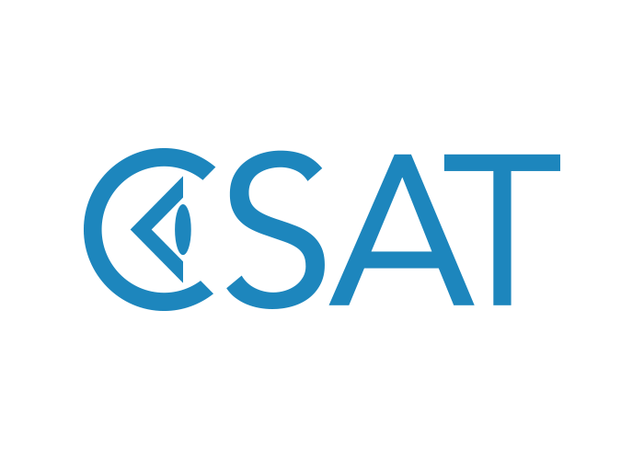
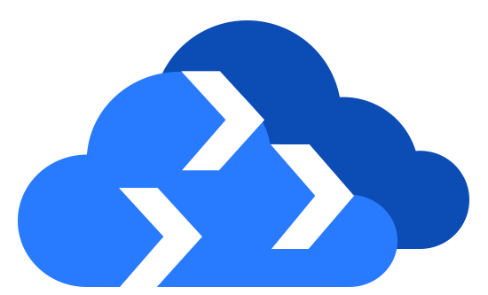

Solution Assessments Accredited Tools
Azure Migrate
Azure Migrate
Lakeside
Cast
Block 64
SAP on Azure Planning Wizard
Lakeside
Cast
Block 64
SAP on Azure Planning Wizard

Slide 16
Solutions Assessments

Slide 17

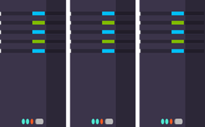
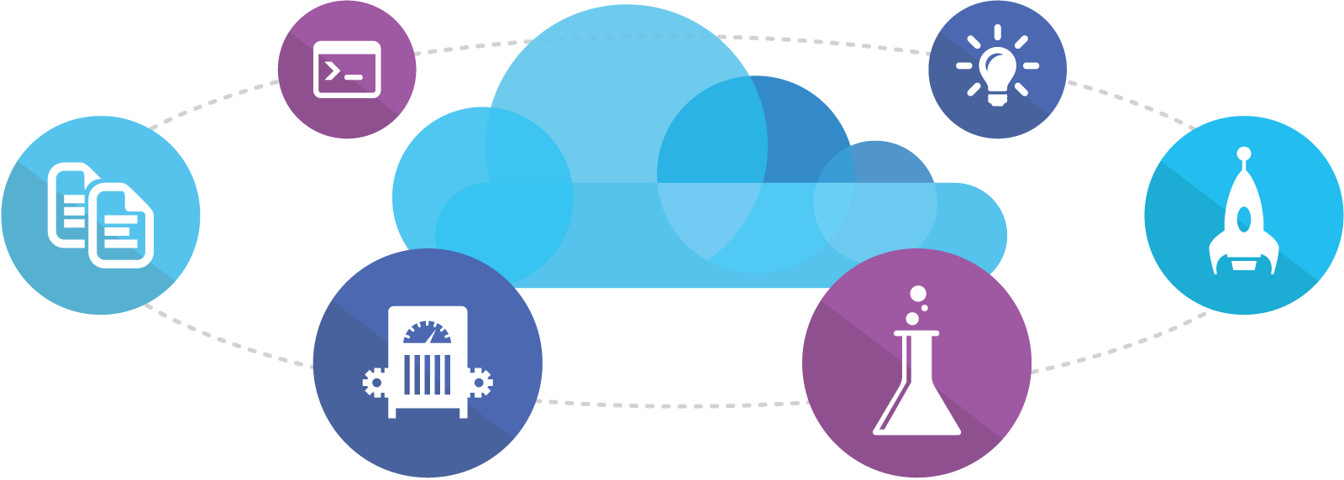
Solution Assessments Portfolio +
Business Value Services Assessment by MCS
E-Commerce Experience Assessment by REVONIC
Power Platform Assessment by Netways
SAP on Azure Assessment by SNP
Teams Voice Assessment by Delphi

Slide 18
Azure/Data & Infrastructure Optimization/Migration Solution Assessment

Slide 19
Solution Assessments Portfolio
Azure
Data & Infrastructure Migration
Helps customers Modernize their server, data centers and provide recommendations for migration to Azure
Application Modernization
Assist customers identify and prioritize applications for Cloud modernization
Azure Foundations
Help customers understand their Cloud maturity and provide steps to digitally transform
Azure Cost Optimization
Help customers manage cloud spending, and increase organizational accountability
Azure Express
Provides early-in-stage customers with a fast data driven analysis, and business case recommendation to start the move to Azure

Slide 20
Azure Assessments … Customer Stage Perspective

Slide 21
Cybersecurity Solution Assessment

Slide 22
If we can’t protect people, then we don’t deserve their trust
Brad Smith
President and Chief Legal Officer

Slide 23
ACCESS MANAGEMENT
CLOUD ACCESS SECURITY BROKERS
ENDPOINT PROTECTION PLATFORMS
Gartner Security & Compliance Magic Quadrants
Full Report Links:
Access Management
Enterprise Information Archiving
Unified Endpoint Management Tools
Endpoint Protection Platforms
Cloud App Security Brokers
ENTERPRISE INFORMATION ARCHIVING
UNIFIED ENDPOINT MANAGEMENT TOOLS
“Best Of Breed & Best Of Suite”
This graphic was published by Gartner, Inc. as part of a larger research document and should be evaluated in the context of the entire document. The Gartner document is available upon request from Microsoft.
Gartner does not endorse any vendor, product or service depicted in its research publications, and does not advise technology users to select only those vendors with the highest ratings or other designation. Gartner research publications consist of the opinions of Gartner’s research organization and should not be construed as statements of fact. Gartner disclaims all warranties, expressed or implied, with respect to this research, including any warranties of merchantability or fitness for a particular purpose.

Slide 24
A leader in security, compliance, identity,
& management

Slide 25
Operation Scale
Meeting
minutes delivered
4.1B+
URLs scanned
18M+
1.8PBs
1.2B+
Other clouds
and network logs
PCs, servers,
and IoT
Trillions of signals
Emails
analyzed
470B+
Billions of predictions
Identities authenticated
630B+
Millions of actions
Microsoft Cloud
Machine learning and AI systems
Documents scanned
600B+
1B+
iOS, macOS, Android, Linux
and IoT devices
Apps and
service users
Threats blocked
5B+

Slide 26
Navigating a shifting world
Conventional security tools have not kept pace
Attacks growing
more sophisticated
Regulatory landscape
becoming more complex

Slide 28
Microsoft Security
Protect
Detect
Respond

Slide 29
Secure your organization with Zero Trust
Verify explicitly | Use least-privileged access | Assume breach
Data
Identities
Apps
Infrastructure
Devices
Security policy enforcement
Network

Slide 30
Comprehensive Security Posture
Identity & access management
Threat
protection
Network
Security
Data & information protection
Security
management
Azure Active Directory
Azure Security Center
Micro-Segmentation (VNET, Service Endpoint, NSG/ASG)
Encryption (Disks, Storage, SQL)
Azure Security Center
Multi-Factor Authentication
Microsoft Antimalware for Azure
Application Gateway
(WAF), Azure Firewall
Azure Key Vault
Azure Log Analytics
Azure Security
Role Based Access Control
DDoS Protection Standard
Confidential Computing
Azure Sentinel
Virtual WAN
(ExpressRoute, VPN)
Azure Active Directory
Windows Hello
Credential Guard
Microsoft Defender Advanced Threat Protection
Office 365 Advanced Threat Protection
Azure Advanced Threat Protection
Microsoft Cloud App Security
Azure Information Protection
Office 365 Data Loss Prevention
Microsoft Information Protection
BitLocker
Microsoft Cloud App Security
Secure Score
Microsoft security and compliance center
Microsoft 365
+ Partner Solutions

Slide 31
Cybersecurity Assessment
An Assessment that gives the customer a comprehensive look at their cybersecurity infrastructure, including current software deployment, and usage, and provides them key insights to help establish the right processes for cyber-risk reduction on-premise and in the cloud.

Slide 32
The Standard Used
Cybersecurity Standards NIST, ISO 27000, HIPPA, FISMA, CIS … etc.
CIS® (Center for Internet Security, Inc.) is a forward-thinking, non-profit entity that harnesses the power of a global IT community to safeguard private and public organizations against cyber threats.
The CIS Controls™ are the global standard and recognized best practices for securing IT systems and data against the most pervasive attacks. These proven guidelines are continuously refined and verified by a volunteer, global community of experienced IT professionals.

Slide 33
The 20 CIS Controls

Slide 34
What is SIEM , What is SOAR ?
• Basic introduction to the SIEM market
The security and information event management (SIEM) market aggregates event data produced by security devices, network infrastructure, systems and applications. Event data is combined with contextual information about users, assets, threats and vulnerabilities. The technology provides real-time analysis of events for security monitoring, query and long-range analytics for historical analysis and other support for incident investigation and management, and reporting (e.g., for compliance requirements).
Basic introduction to the SOAR market
The Security orchestration, automation and response (SOAR) have been in the market since late 2017, with most focused on how to make security detection functions more effective and efficient. The SOAR technology market aims to converge security orchestration and automation (SOA), security incident response (SIR) and threat intelligence platform (TIP) capabilities into single solutions.
The ability to automatically fix an issue without some form of human-led analysis in the loop is the key selling point. However, the truth around successfully implementing such functions is that it is far from simple. The scope of such functionality is greatly exaggerated, and a fully automated security response is a myth.

Slide 35
Business Continuity Solution Assessment/s

Slide 36
Business Continuity Customer Needs
Work from Home
Using any Device
Work Securely
Optimized DC with DR
Teams
Windows Virtual Desktop
Cybersecurity
Modern DC & DR

Slide 37
Business Continuity Assessments

Slide 38
Thank You!

